Slide 1
Chapter 42 Diffraction

Slide 2
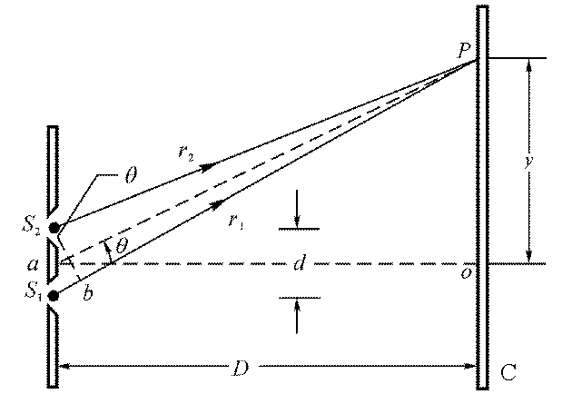
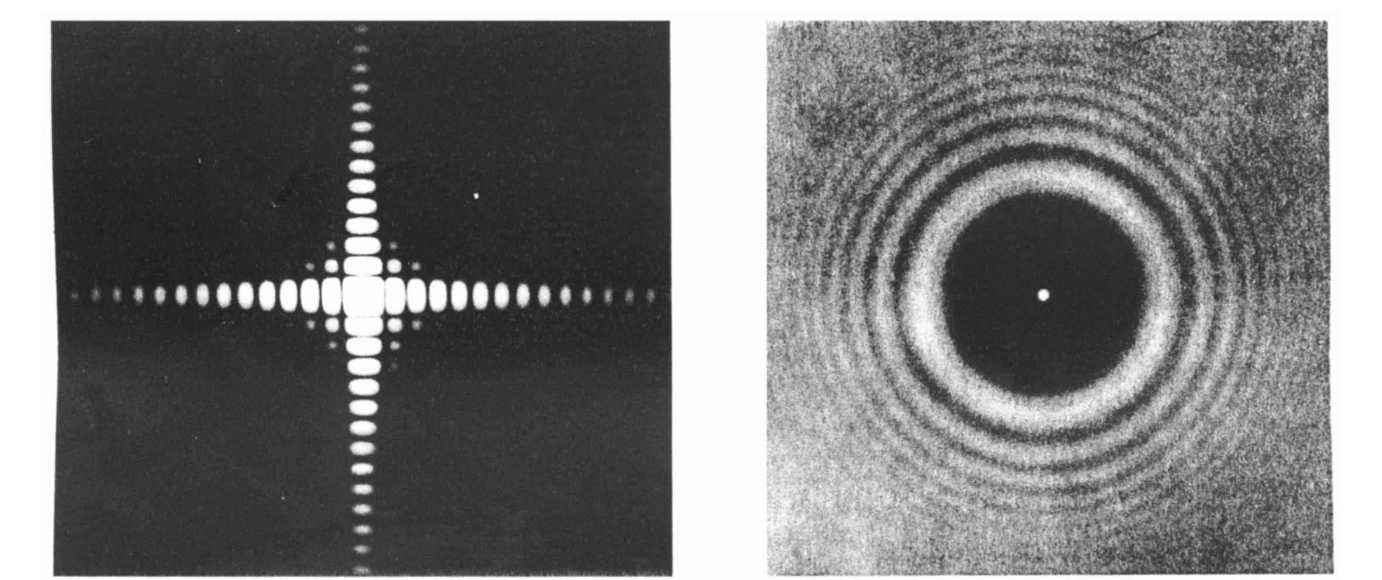
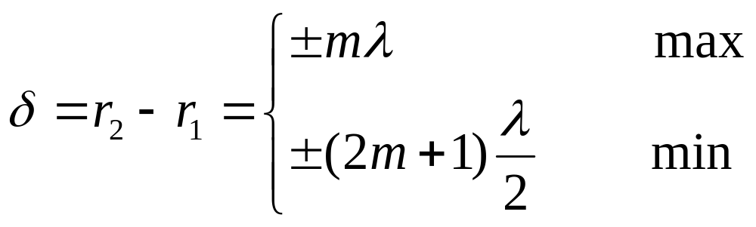
Interference
Diffraction
When a light passes through a hole, or meets a disk etc., with dimensions comparable to the wavelength, we can see patterns on the screen behind them.
The wave nature of light

Slide 3
Content of this Chapter
Diffraction and the wave theory of light
Single-slit diffraction
Intensity in single-slit diffraction
Diffraction at a circular aperture
Double-slit interference and diffraction
combined

Slide 4
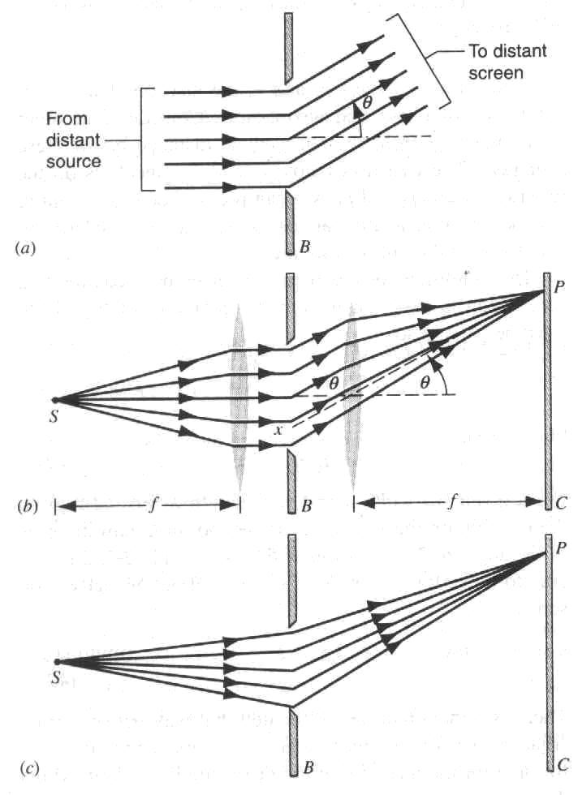
Fraunhofer diffraction —infinite separation
Fresnel diffraction—finite separation

Slide 5
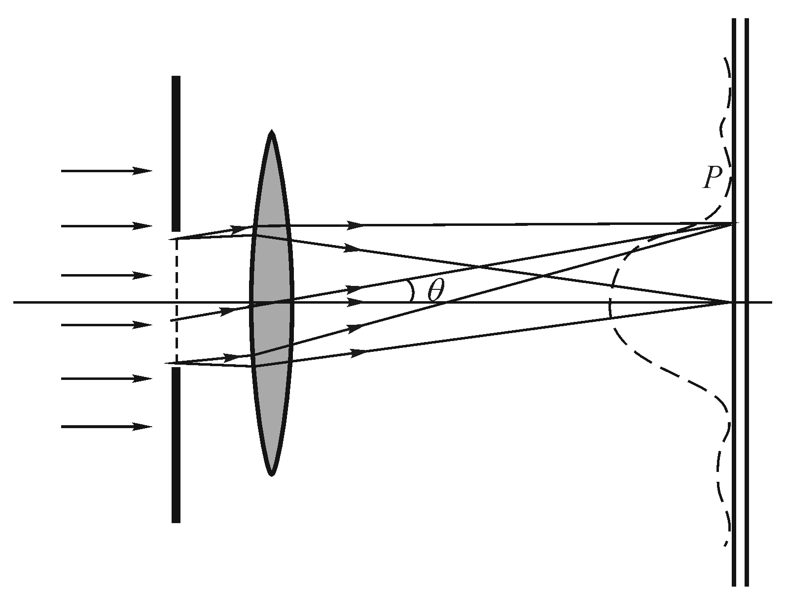
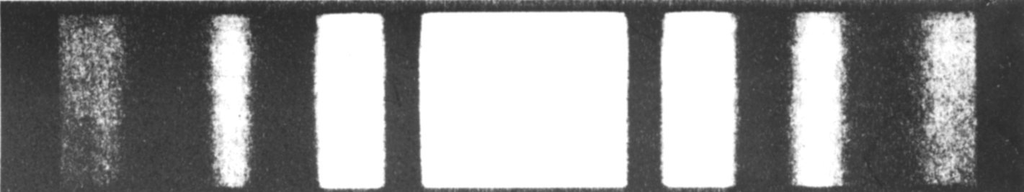
Fraunhofer diffraction —infinite separation
Fresnel diffraction—finite separation

Slide 6
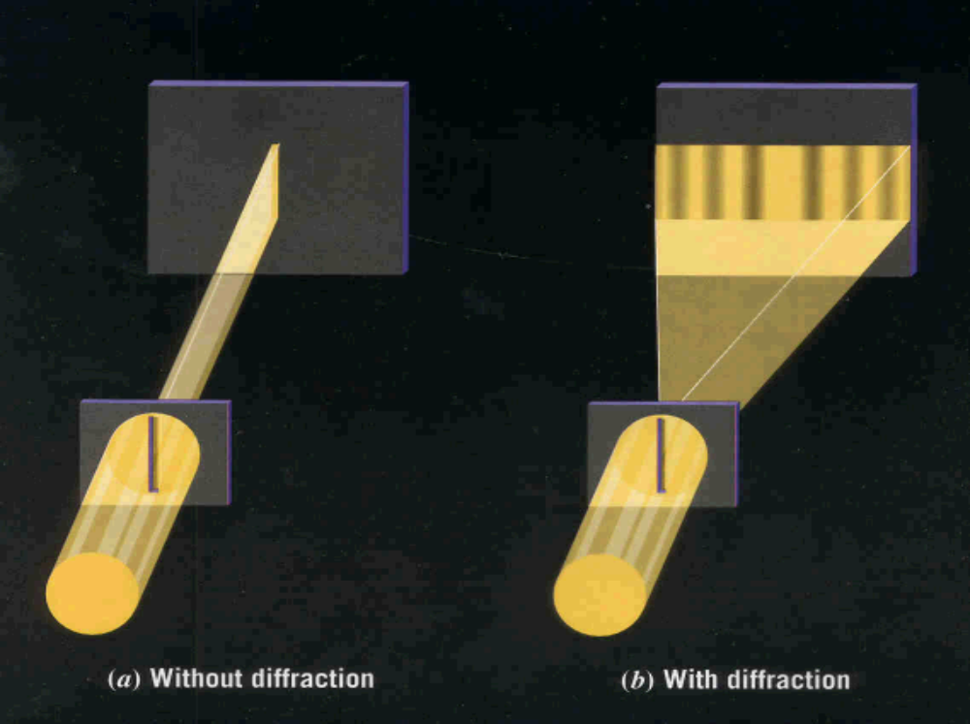
Single-slit diffraction

Slide 7
Single-slit diffraction

Slide 8
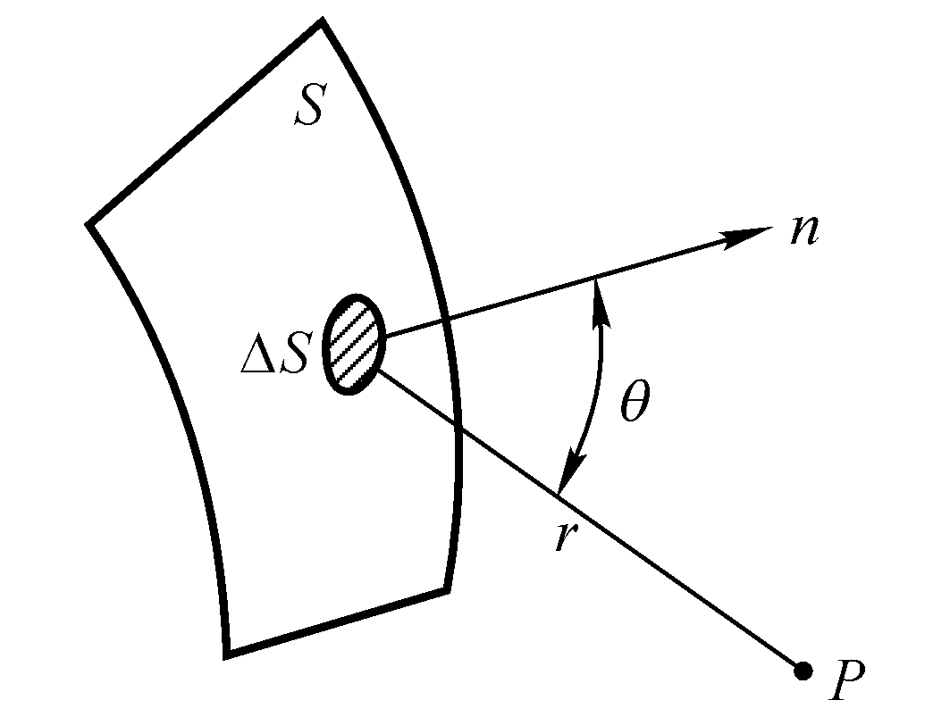
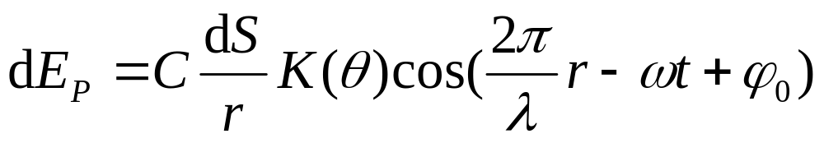
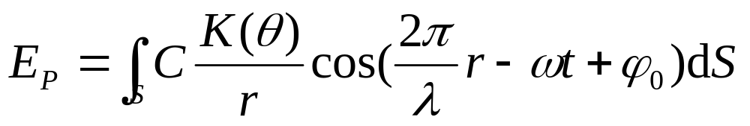
 Fresnel’s theory of light (1788-1827)
Makes it feasible for calculation of intensity at any point on screen

Slide 9
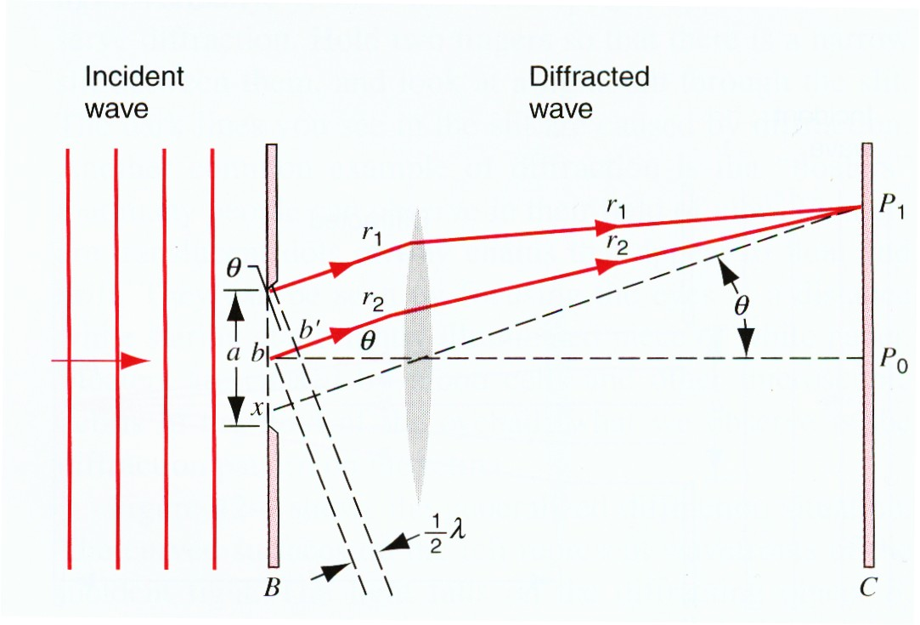
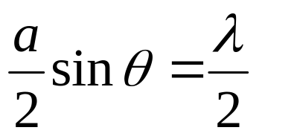
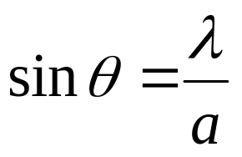
 Half-wavelength strip:
The first minimum of the diffraction pattern

Slide 10
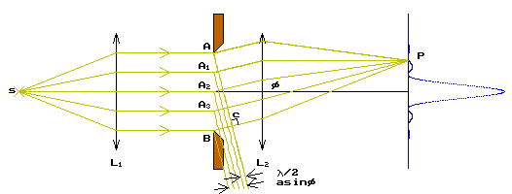
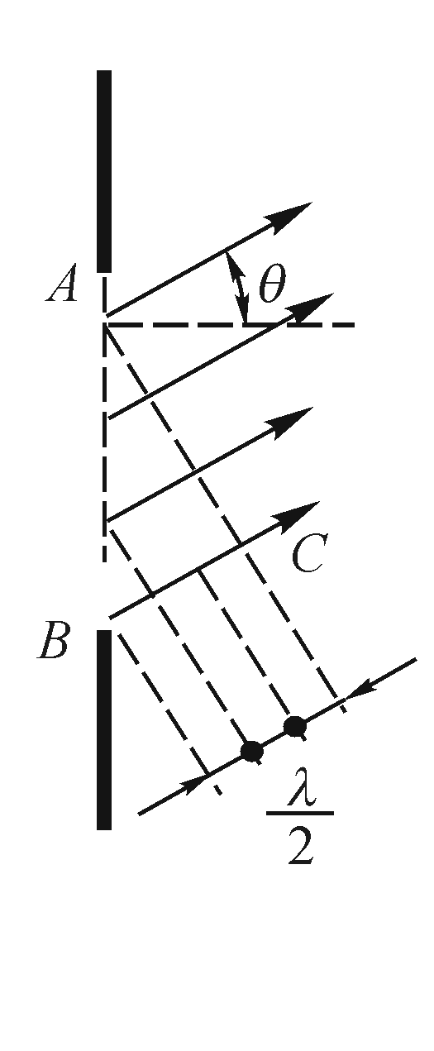
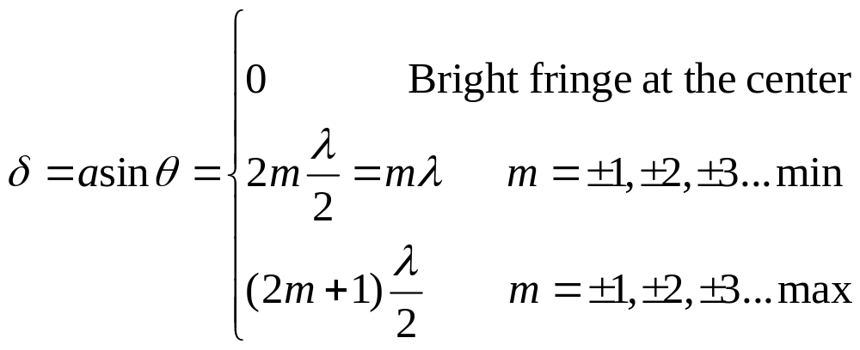
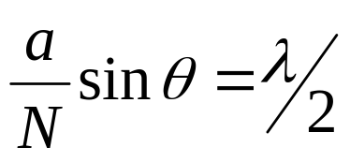
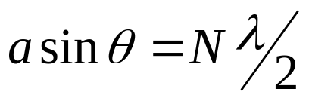

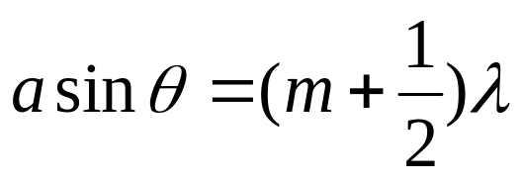





The whole slit is divided into N strips so that the adjacent rays have path difference of a half-wavelength:

Slide 11
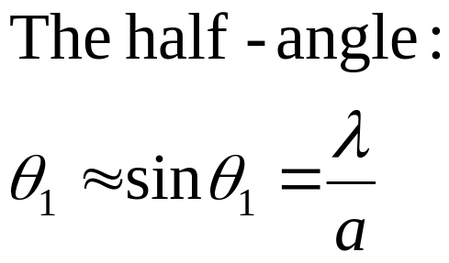
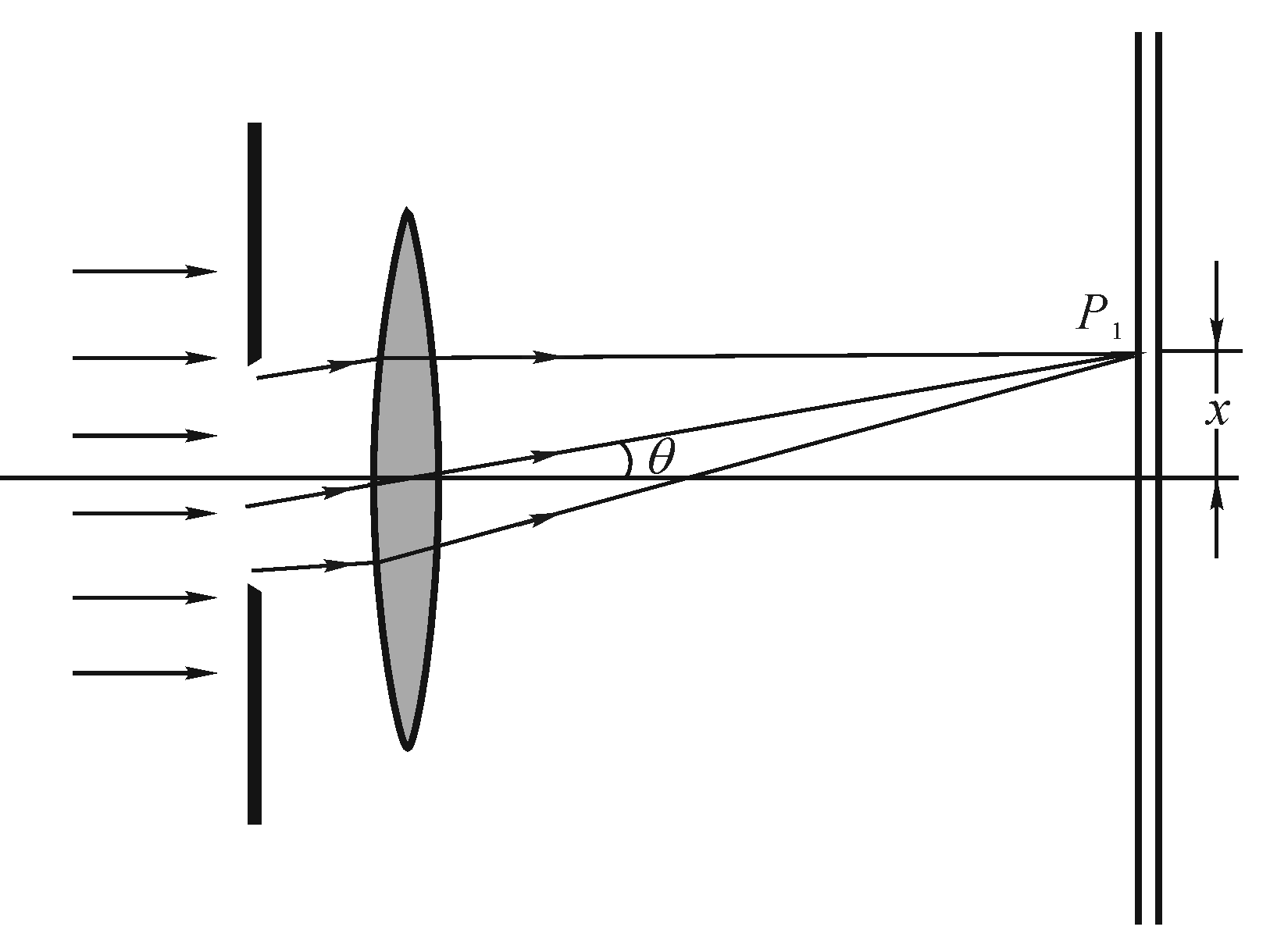
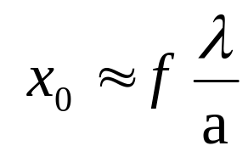
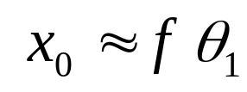
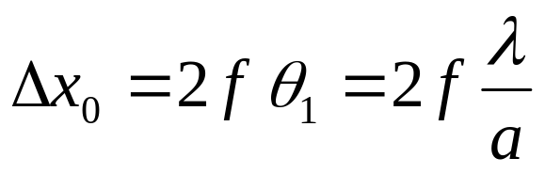

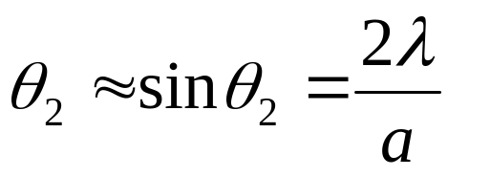
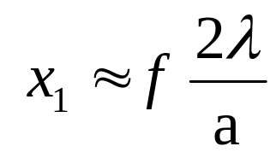
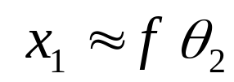
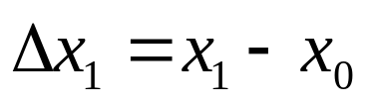
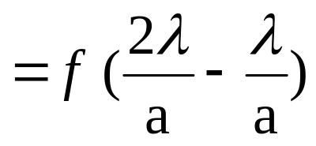
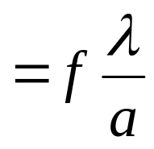
Width of the bright fringe at the center:
x₁
The other fringes:

Slide 12
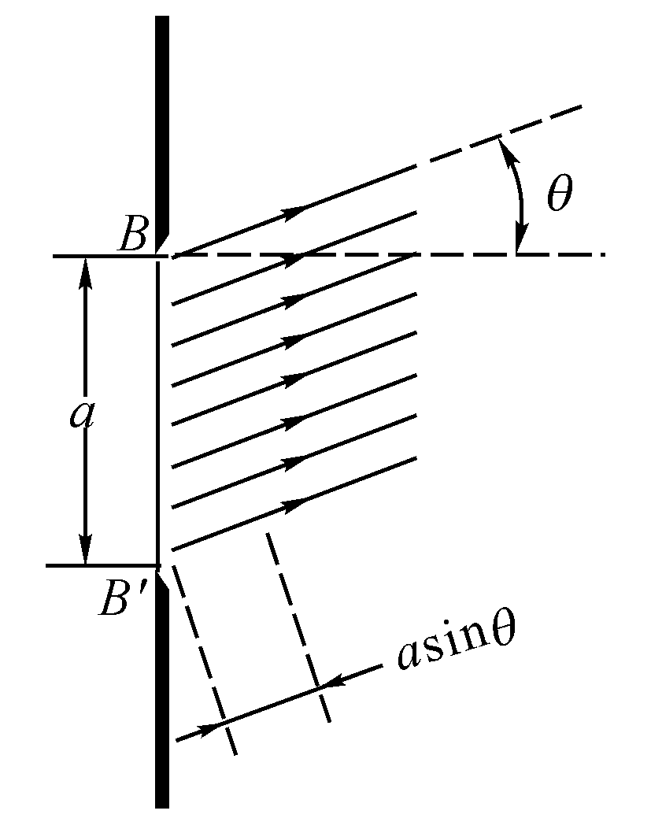
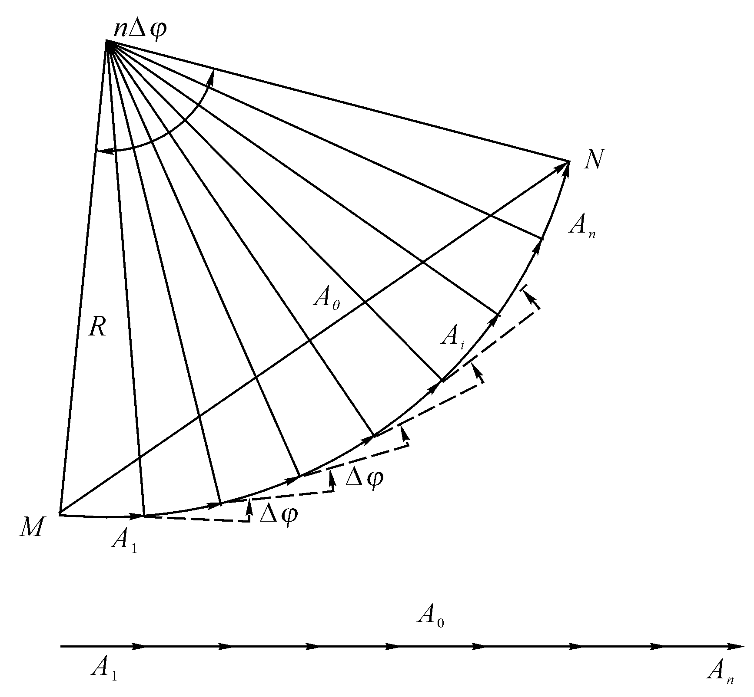
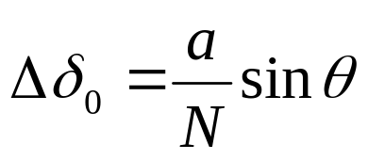
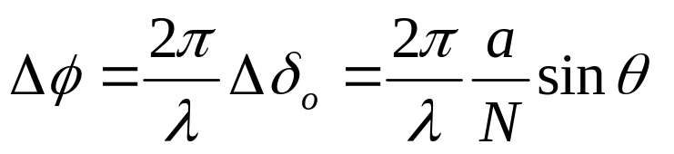
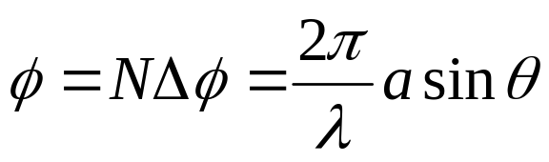
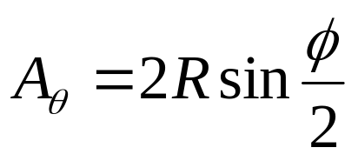
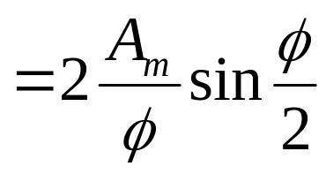
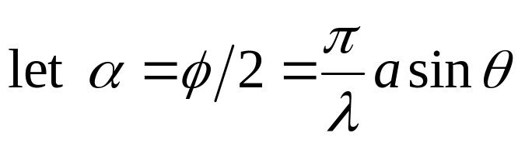
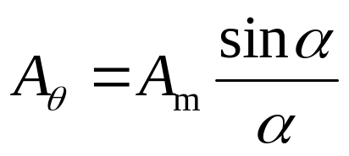
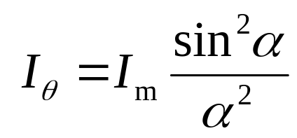
Intensity in single-slit diffraction
The whole slit is divided into N strips with Δx = a/N, which can be regarded as Huygen’s wavelet, therefore,

Slide 13
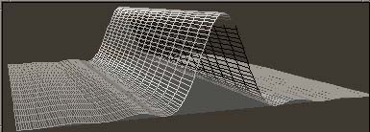
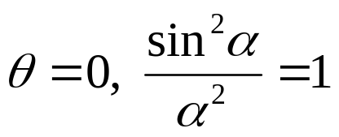
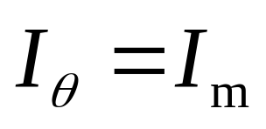




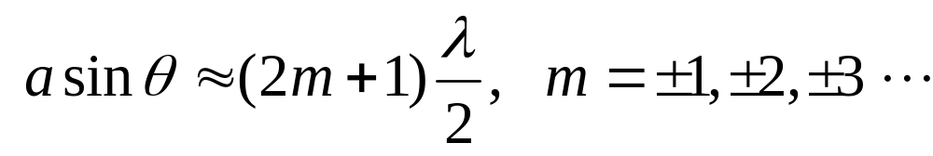



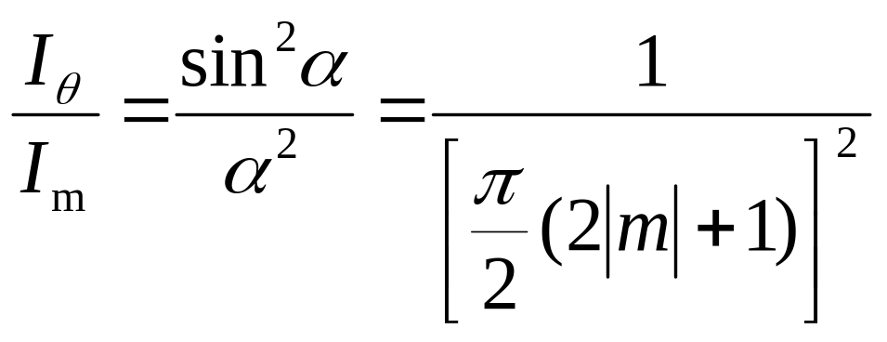
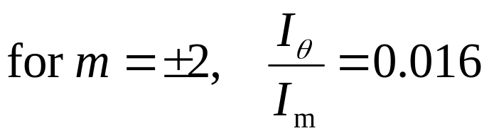
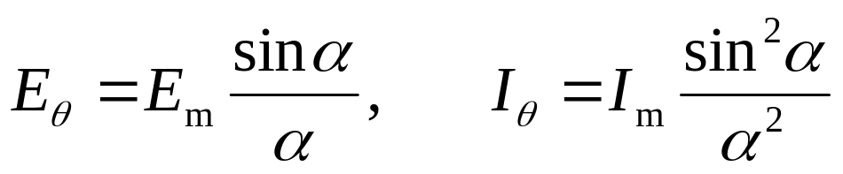
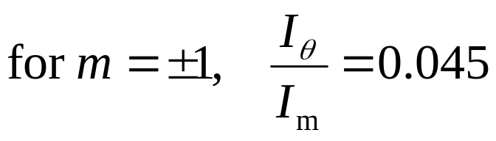
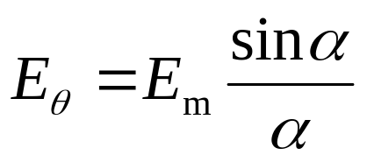
Intensity in single-slit diffraction
The whole slit is divided into N strips with Δx = a/N, which can be regarded as Huygen’s wavelet, therefore,

Slide 14
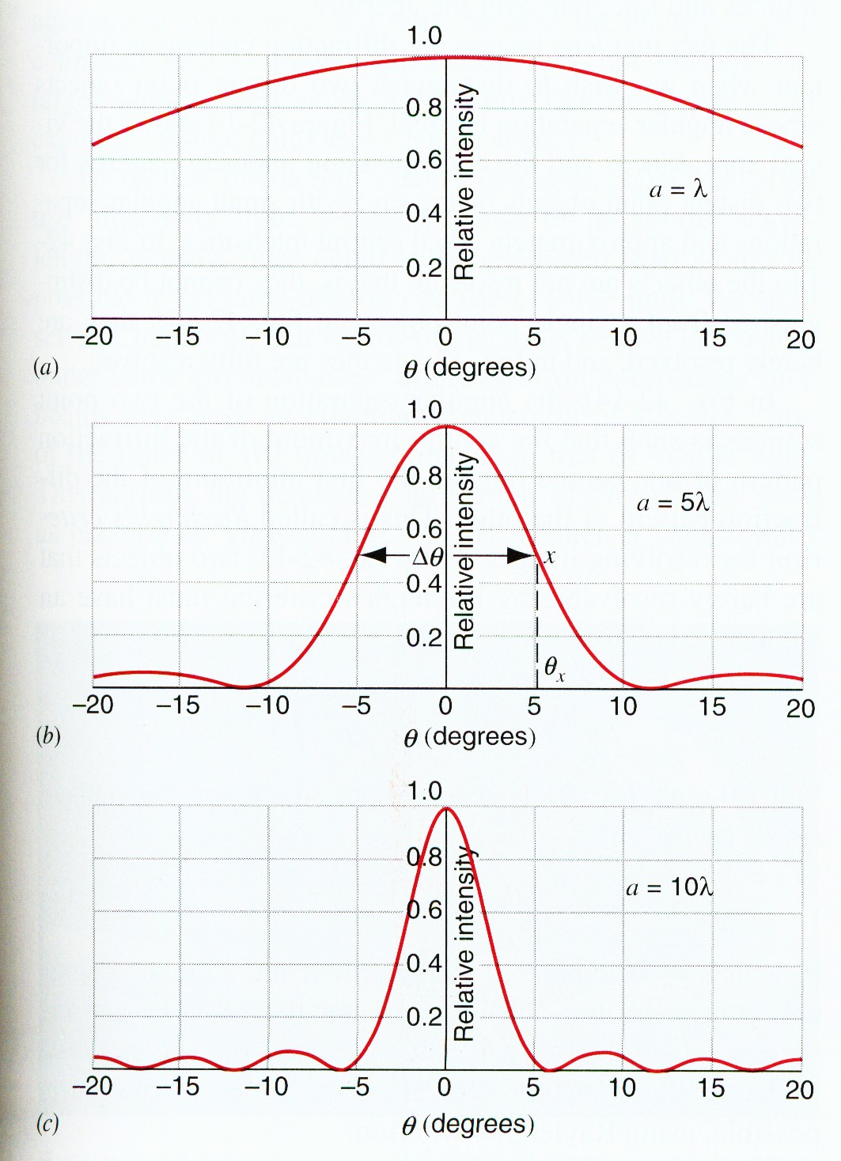








Slide 17




Single-slit diffraction
Diffraction at a circular aperture

Slide 18



Width of the bright fringe at the center:
Central maximum
θ
Diameter d
light
First diffraction minimum is at

Slide 19

resolved
just resolved
not resolved

Slide 20
resolved
just resolved
not resolved

Slide 21





resolved
just resolved
not resolved
Two objects are just resolved when the maximum of one is at the minimum of the other.

Slide 22



Interference
Two waves
Difference of Optical Path Length
Diffraction
One wave
Many waves

Slide 23

Interference

Slide 24
Interference
Diffraction

Slide 25

Interference
Diffraction
Combined

Slide 26










Double-slit Interference and Diffraction Combined
Each slit
Combined

Slide 27
















Double-slit Interference and Diffraction Combined
R

Slide 28









The width of the central fringe is dependent on λ/a.
There will be m-1 fringes on each side of the central fringe for a total of N fringes in the central maximum, where N is given by N=2m-1.
the mth maximum
the first minimum
missing fringes
if m=d/a

Slide 29





Example
A slit of width a = 0.5 mm is illuminated by a monochromic light. Behind the slit there placed a lens (f = 100 cm), and the first maximum fringe is observed at a distance of 1.5 mm from the central bright fringe on the focal plane (screen). Find the wavelength of the light, and the width of the central bright fringe.

Slide 30



Example
A typical astronomical telescope has a lens with a dimension of 10 m. Find the minimum resolving angle. Considering we use this telescope to observe the moon surface. What is the separation of two objects can just be resolved? (take wavelength of 540 nm)

Slide 31


Example
Two slits with separation of d = 5.5 mm is illuminated by a monochromic light. There are 21 fringes in the central maximum. What is the width of each slit?
The missing fringe is 11th.
11=d/a
a=d/11=0.5mm
a=0.5mm

Slide 32
Exercises
P977-978 7, 9, 17, 27
Problems
P979 7

